Slide 1
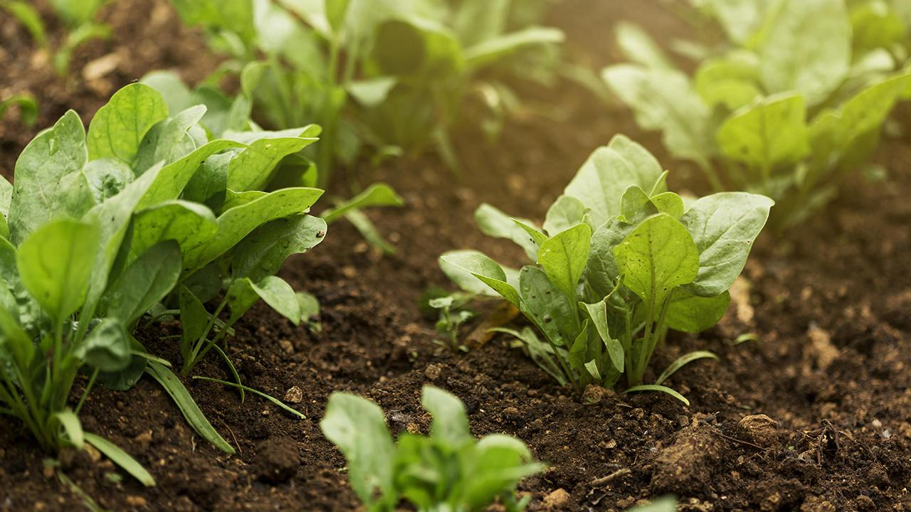

Determination of Plant Health using NoIR Camera and Implementing vSLAM
A PROJECT BY
Aakash Singhal Aniket Dhole Rahul Kumar Satvik Tyagi Vishnu Rohit A.
UNDER THE GUIDANCE OF
Dr. Kris Dorsey

Slide 2
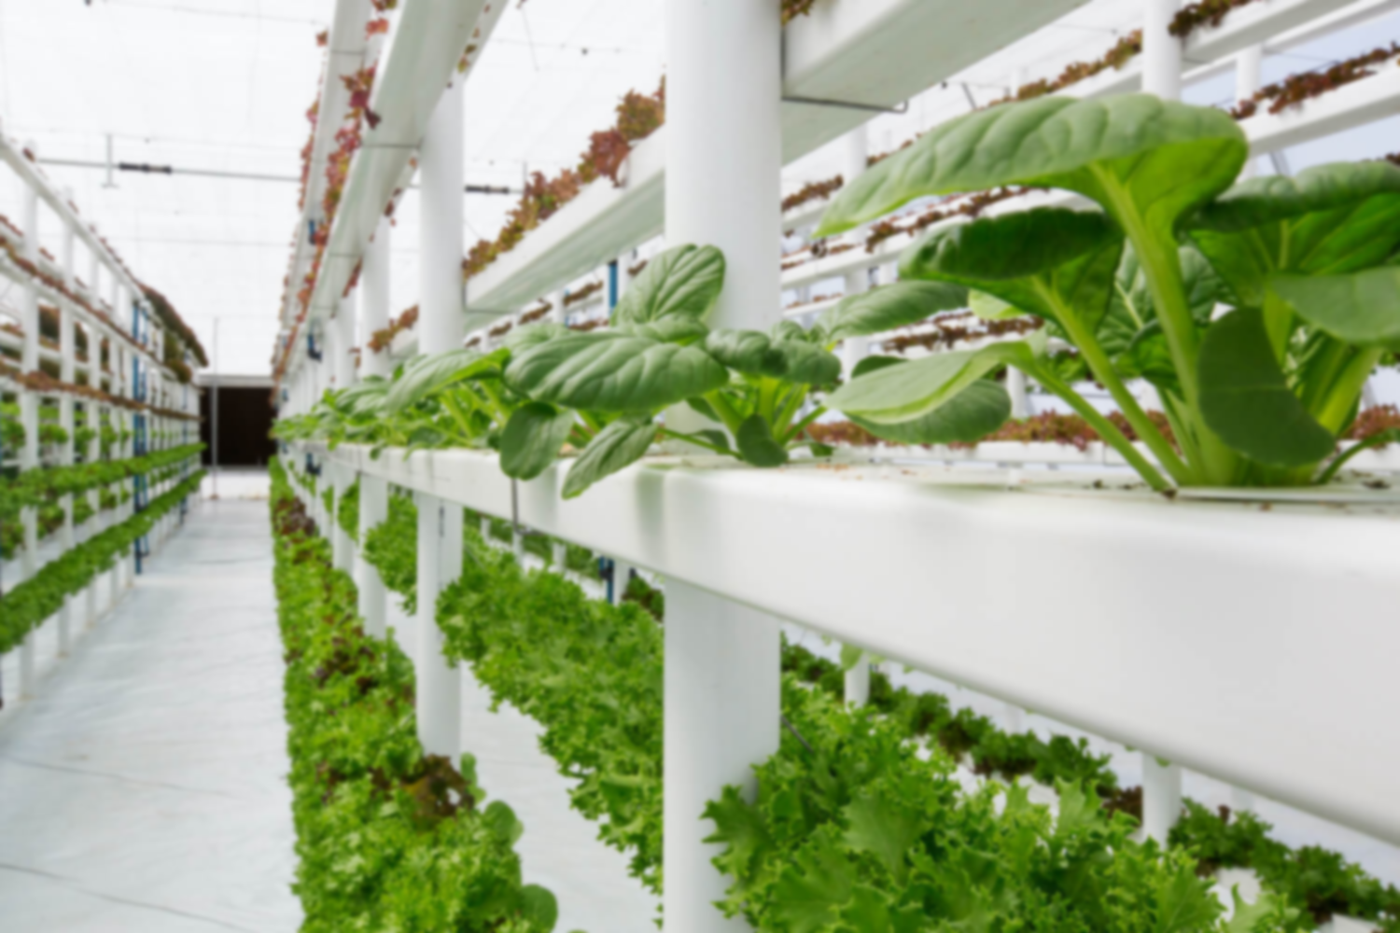
LET’S SET OUR SCENARIO
INDOOR CROPS
CONTROLLED ENVIRONMENT
CONTINUOUS MONITORING

Slide 3
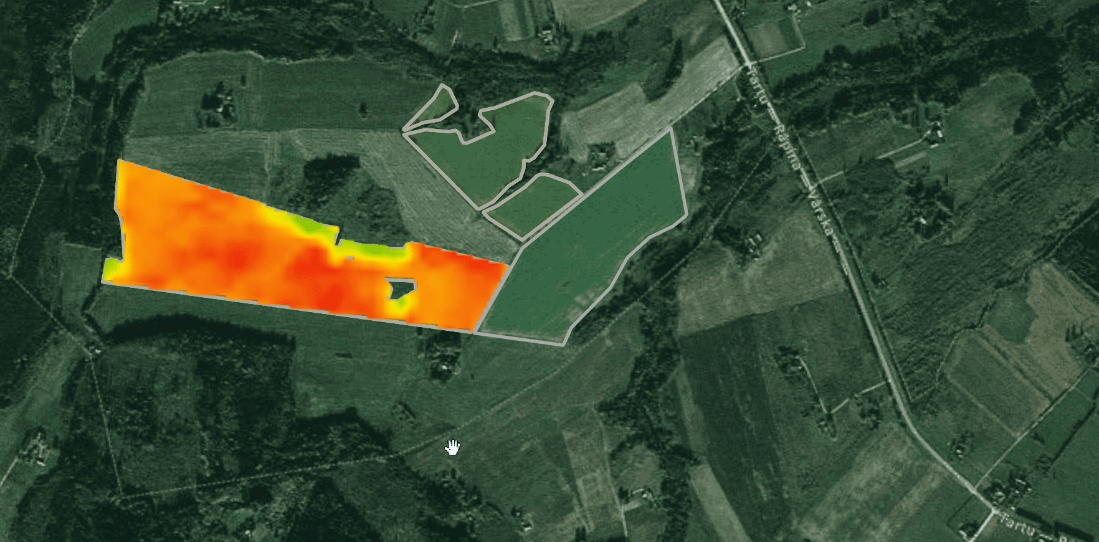
SATELLITE DATA
Satellite based plant health monitoring is available for large areas of land/crops in the United States.

Slide 4
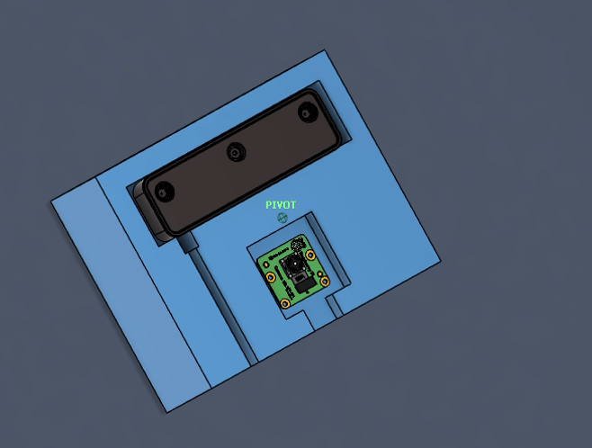
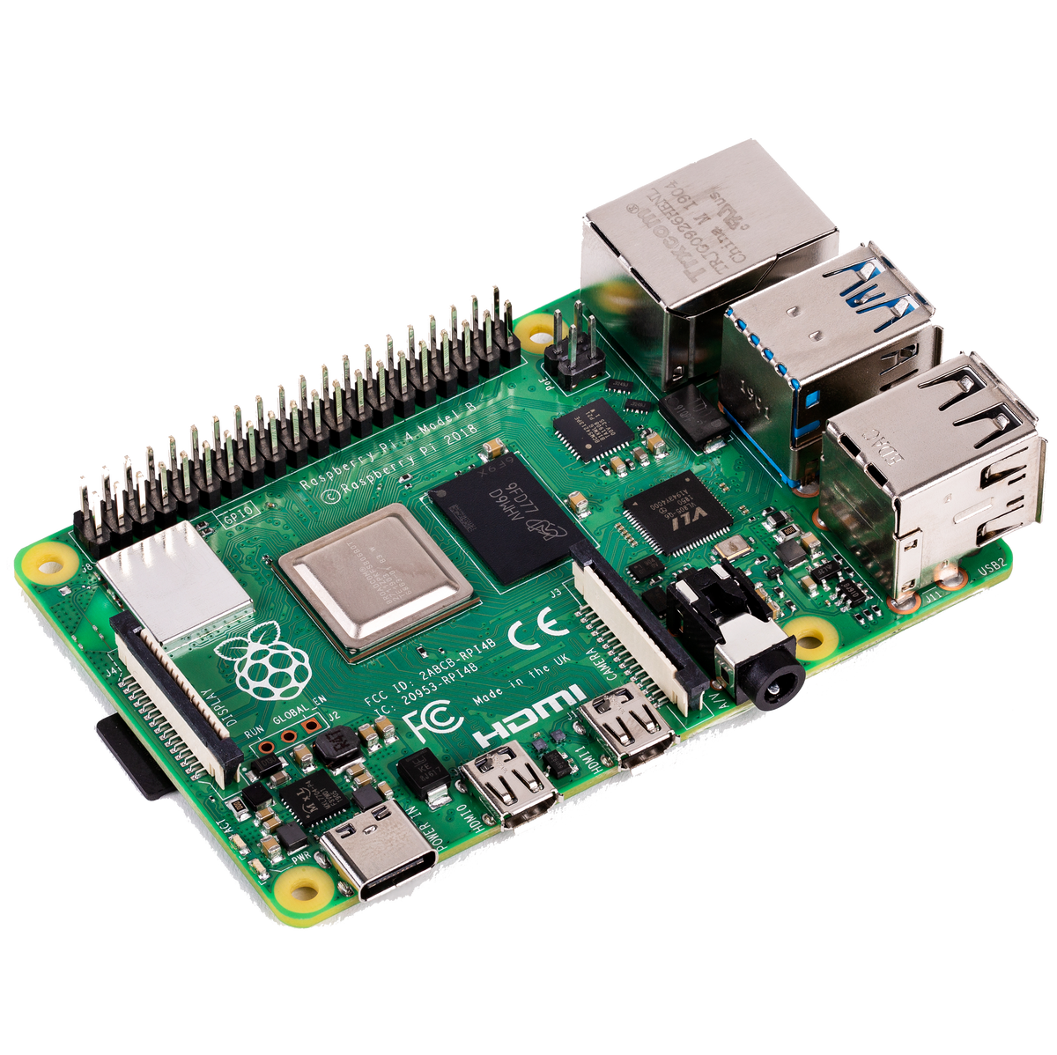
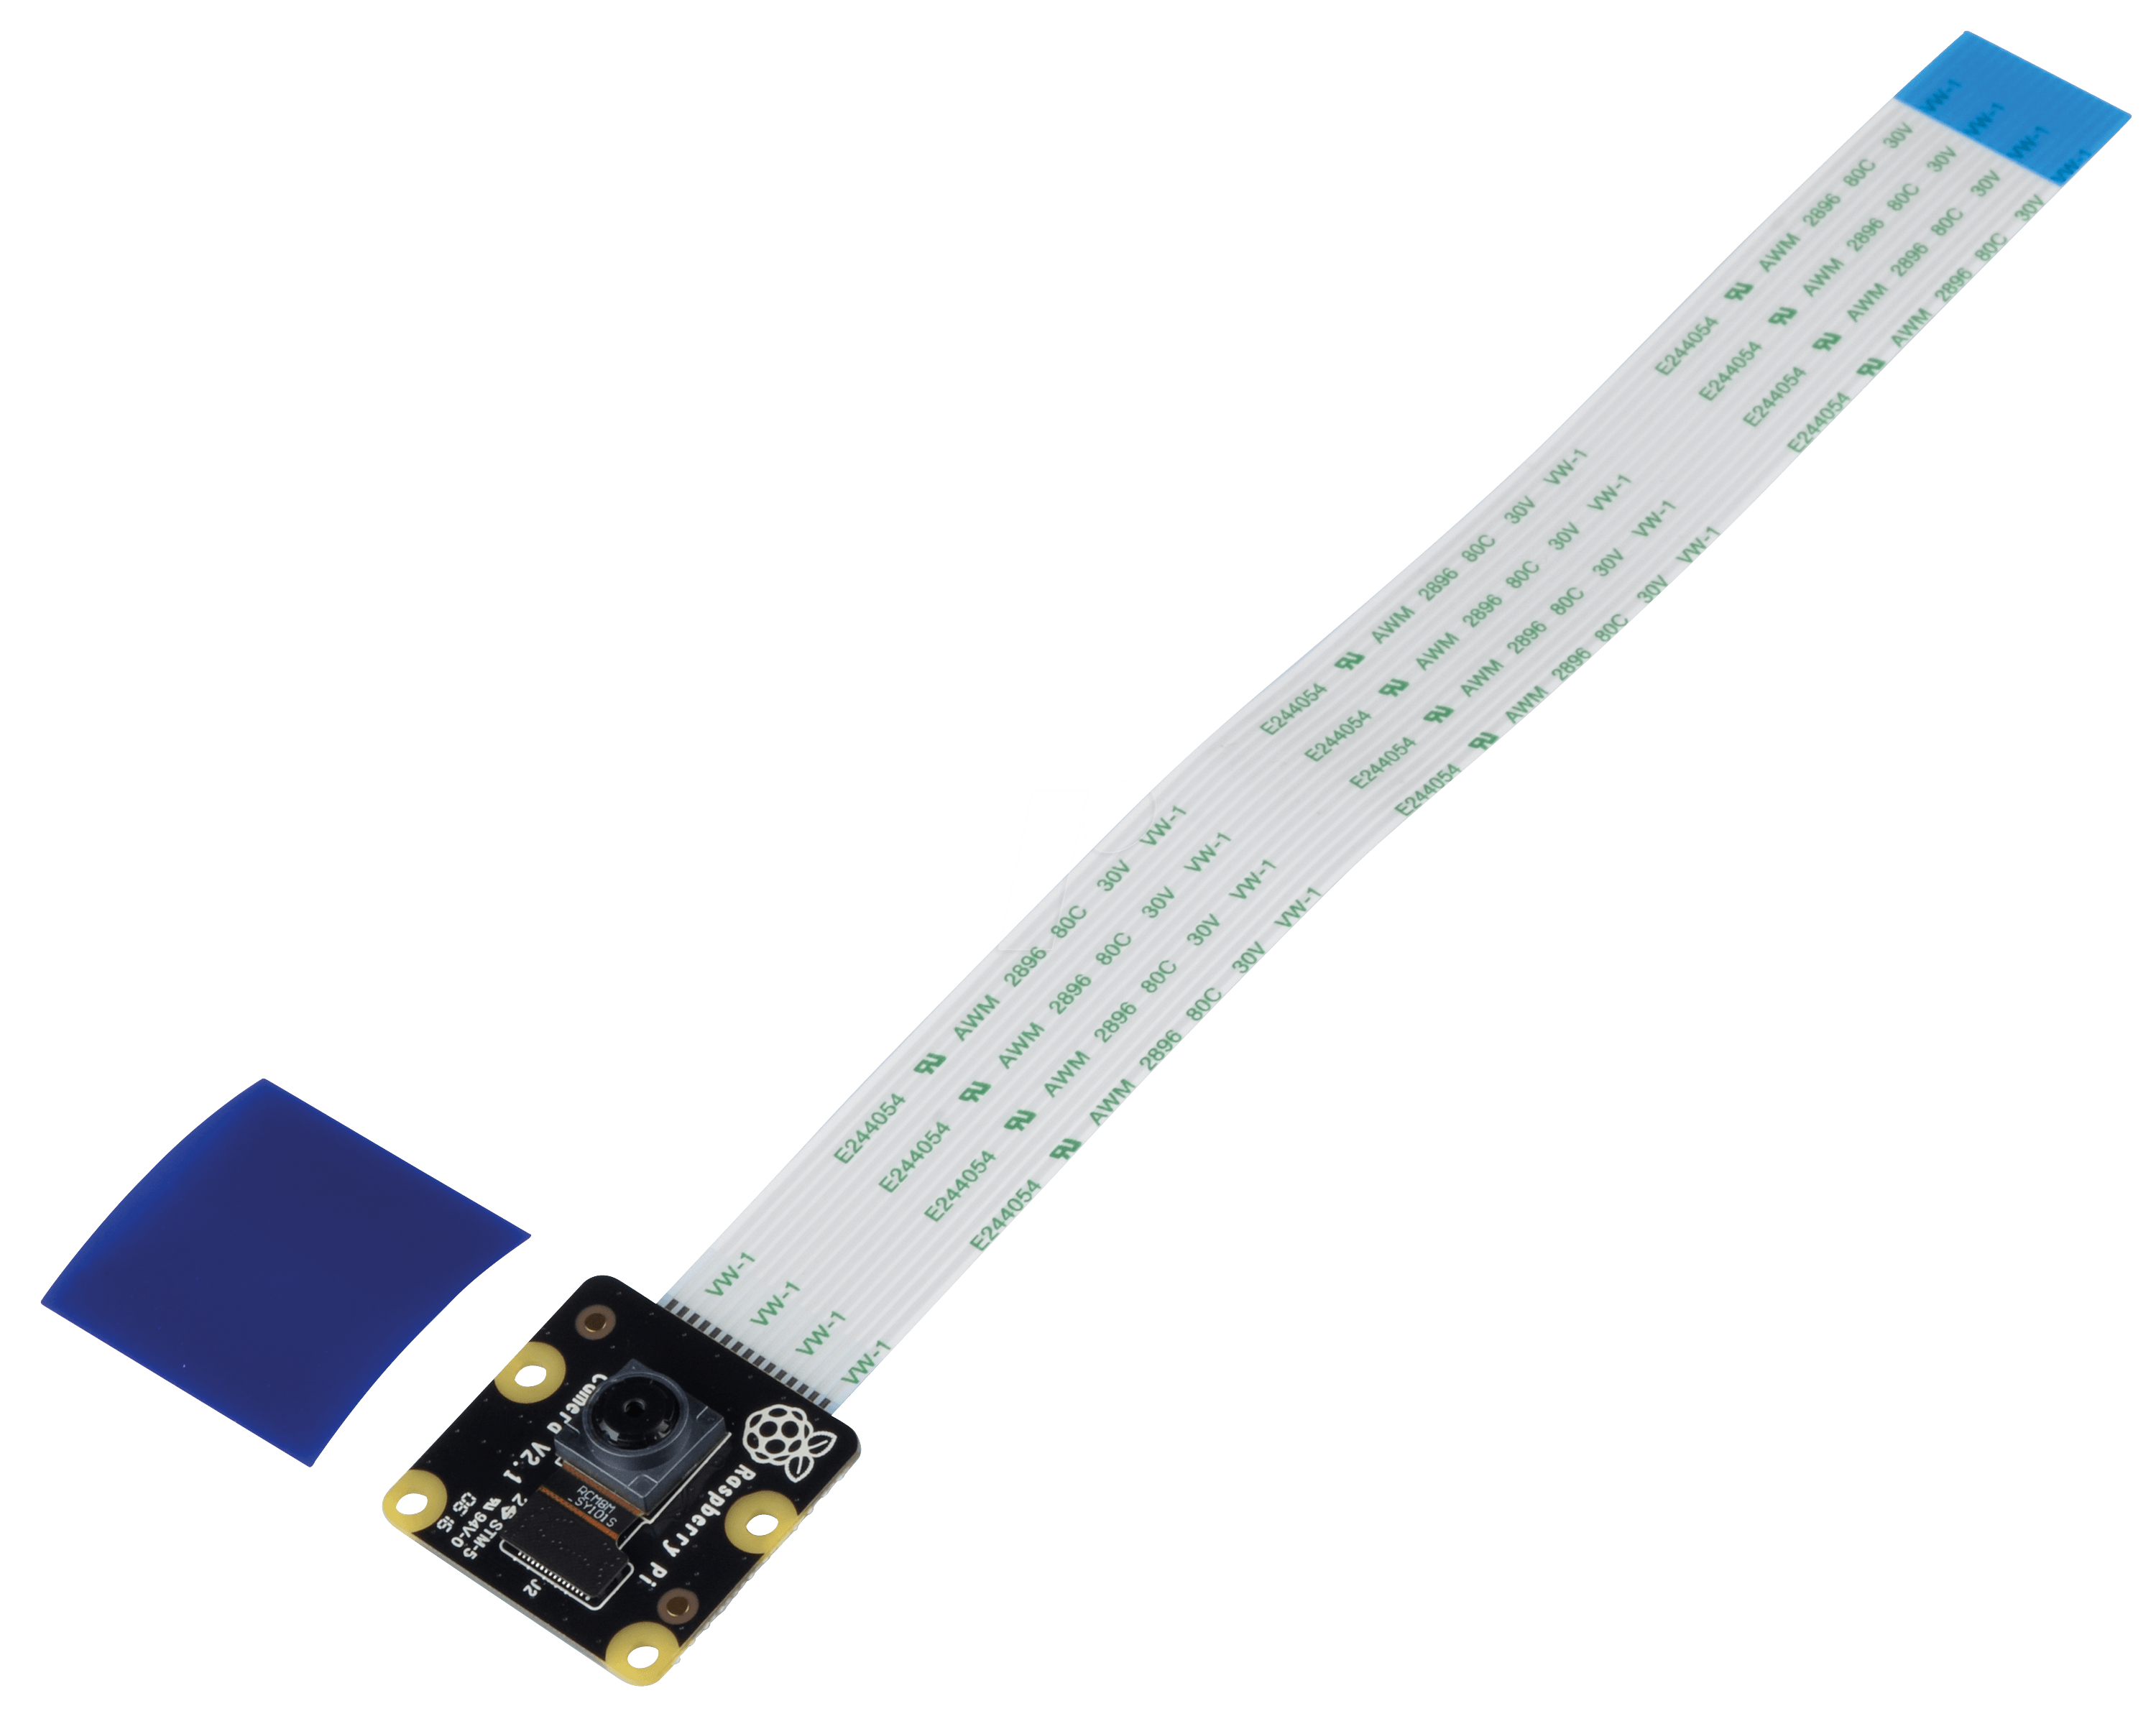
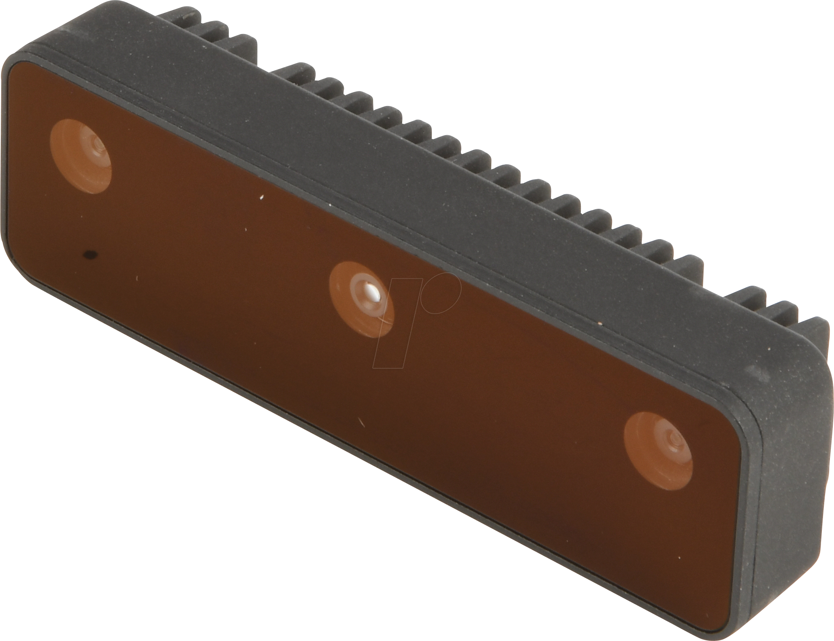
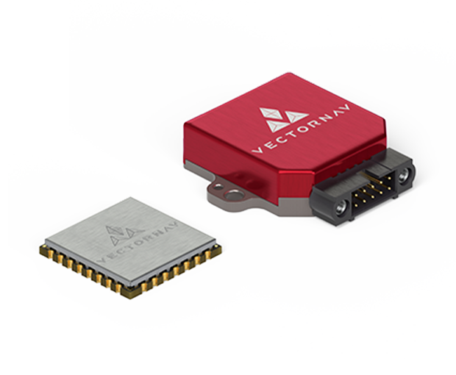
HARDWARE USED
Raspberry Pi 3,
NoIR Camera
Stereo Camera,
IMU

Slide 5
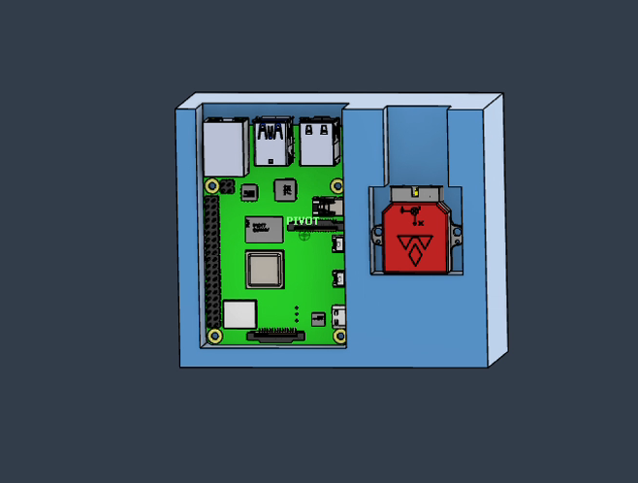
HARDWARE USED
Raspberry Pi
NoIR Camera

Slide 6
HARDWARE USED
Stereo Camera
IMU

Slide 7
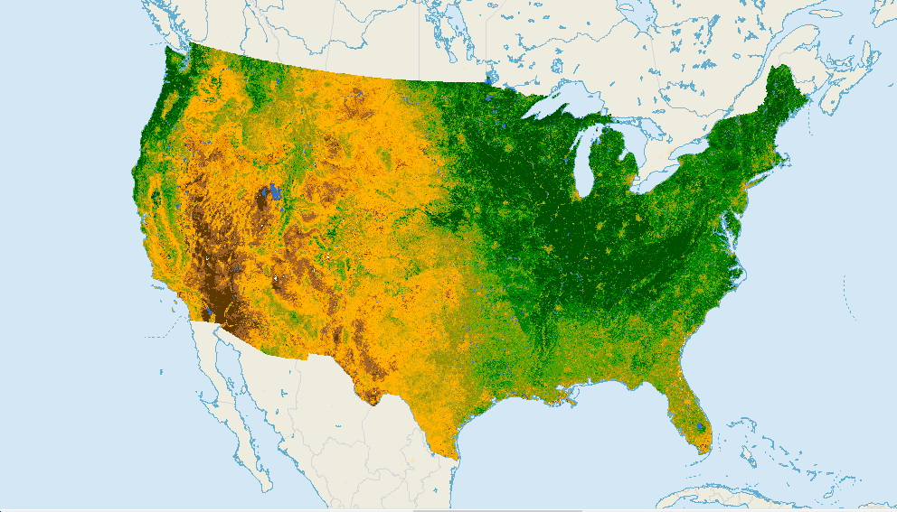
NORMALIZED DIFFERENCE VEGETATION INDEX

Slide 8
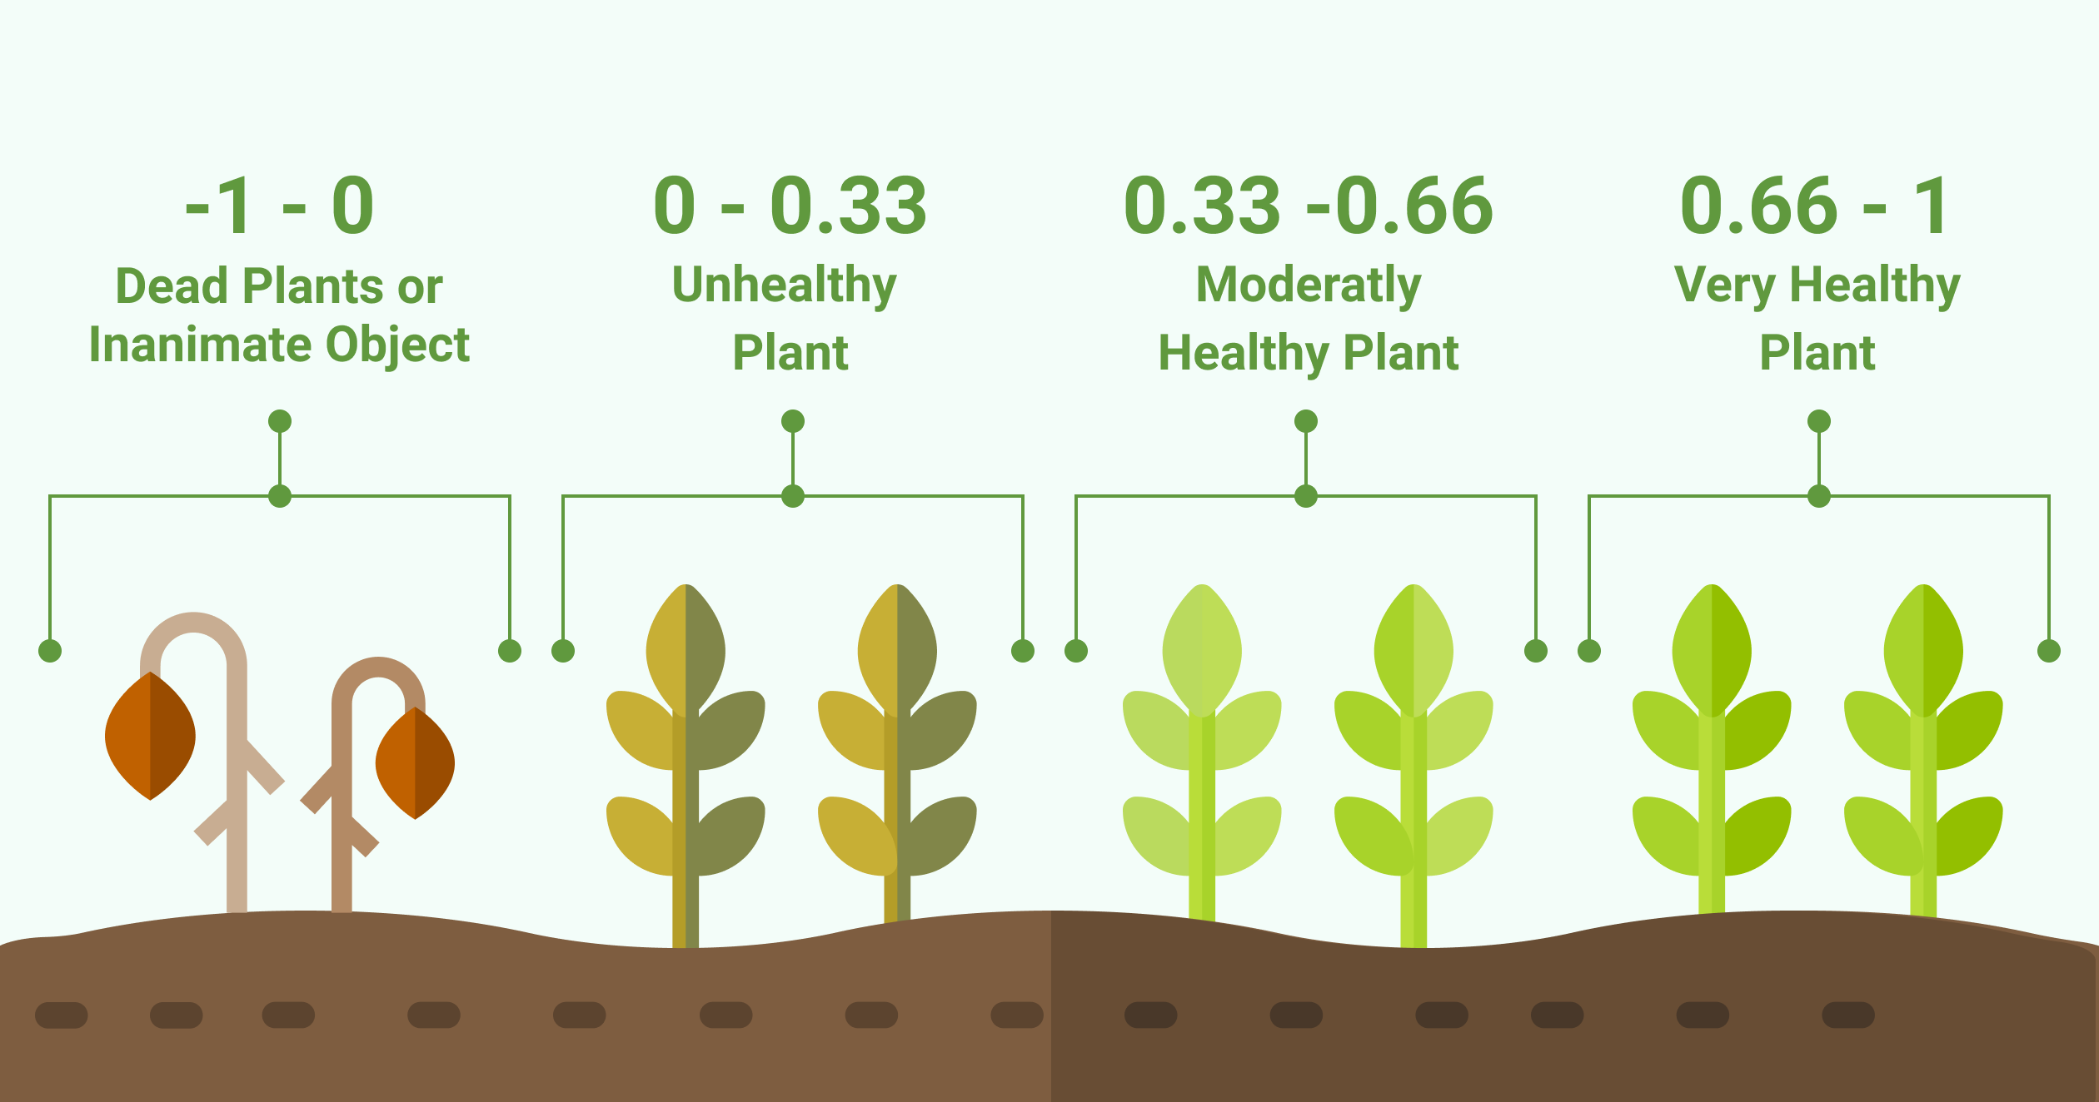

PLANT HEALTH BASED ON THE NDVI SCALE

Slide 9
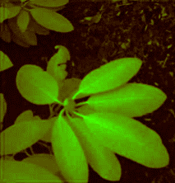
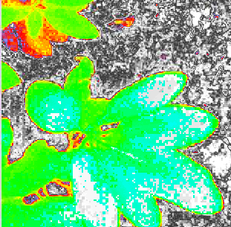

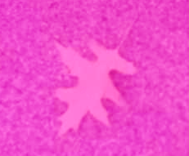
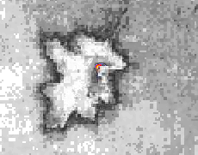
NoIR Camera Results
Actual Image
Plant Health (visualized)
+1
-1
NDVI
Colour
Index
Value
NDVI

Slide 10
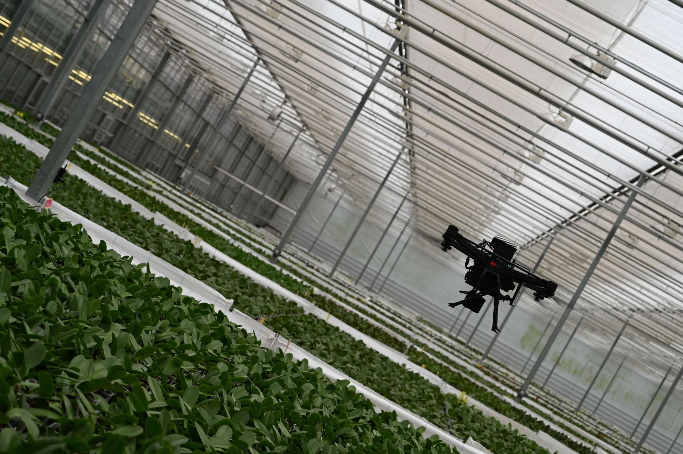
Visual SLAM

Slide 11
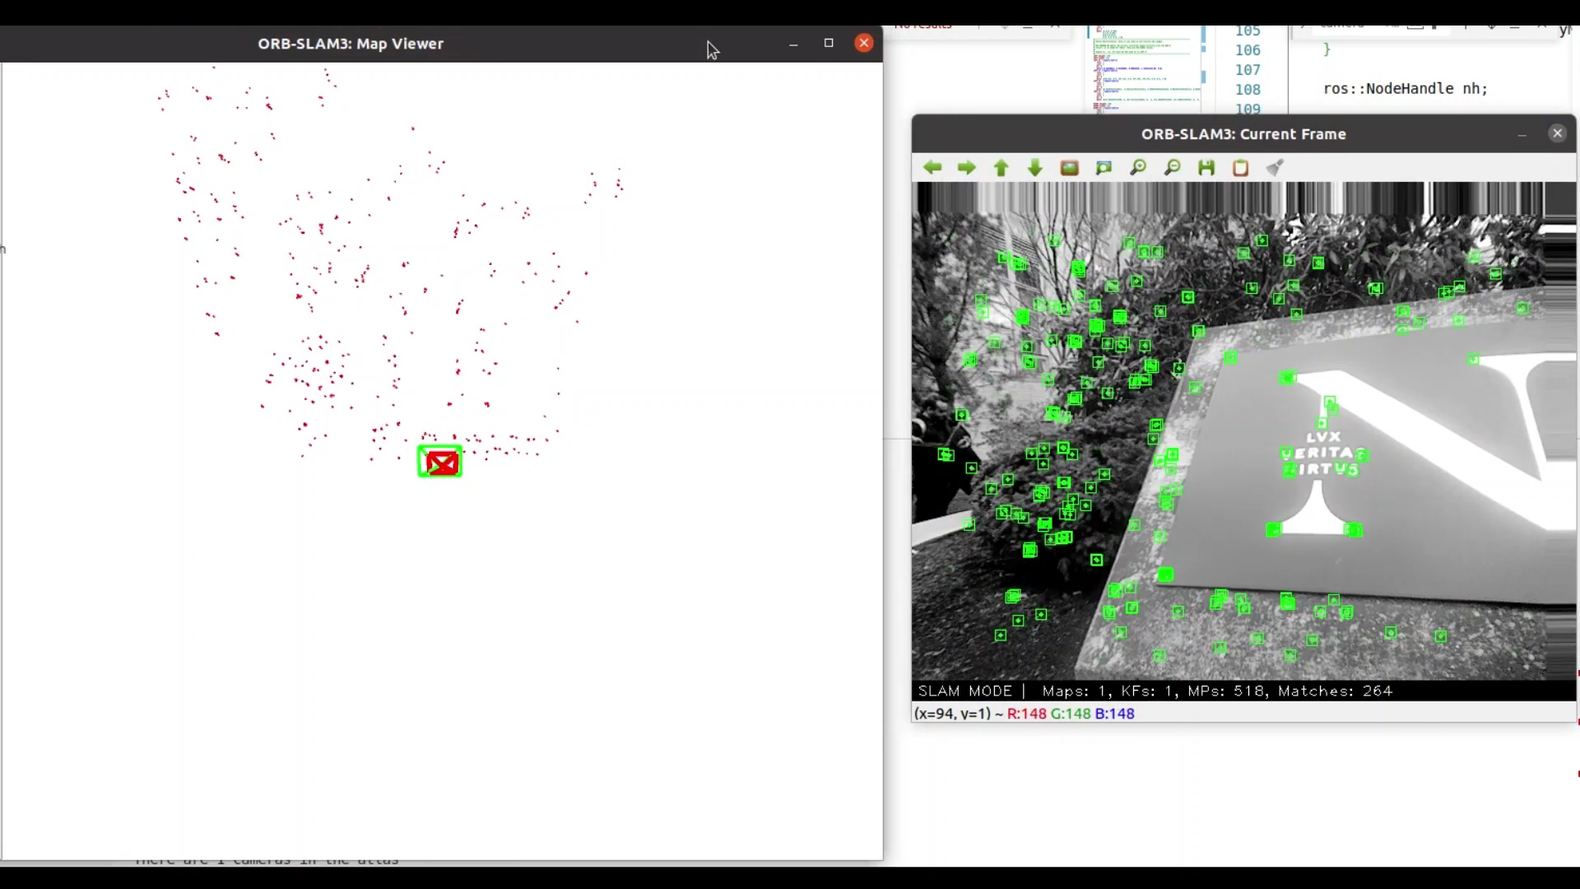
ORB-SLAM using Stereo Camera

Slide 12
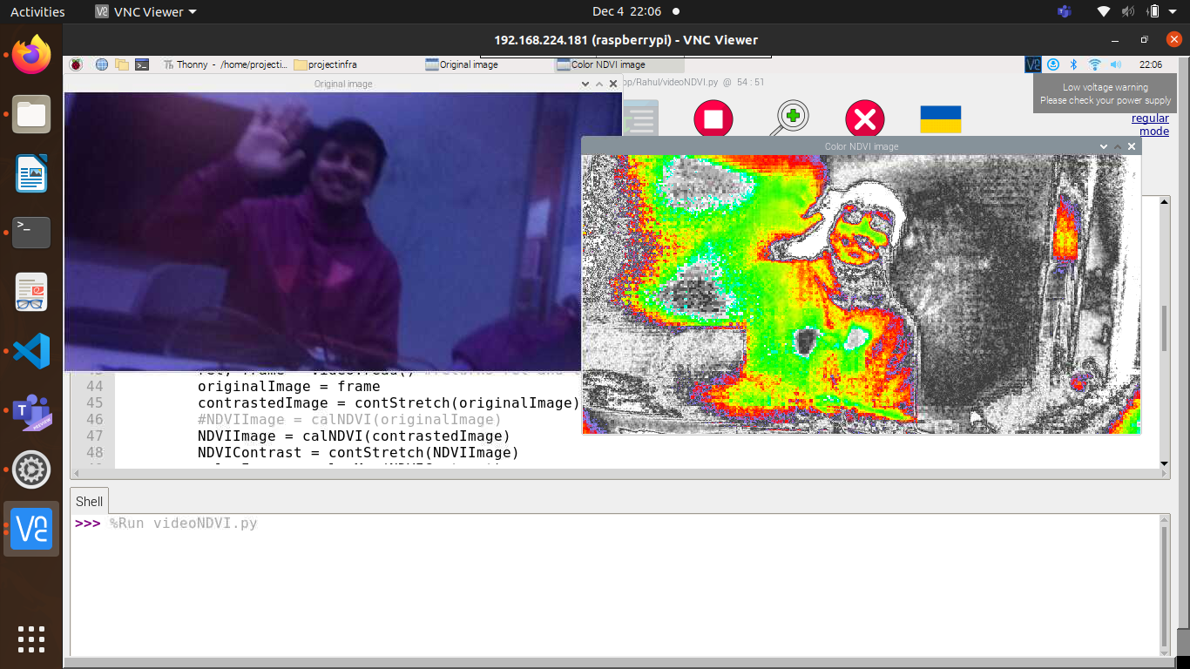
This was just a Sneak Peek. More “why?”s to be answered! COME VISIT US TO KNOW MORE!
in picture: Aniket Dhole

Slide 13
Why NoIR Camera?
Stands for No InfraRed.
Normal cameras usually have inbuilt infrared filters blocking infrared rays.
NoIR cameras have No InfraRed filters, hence capturing infrared rays as well.

